Slide 1
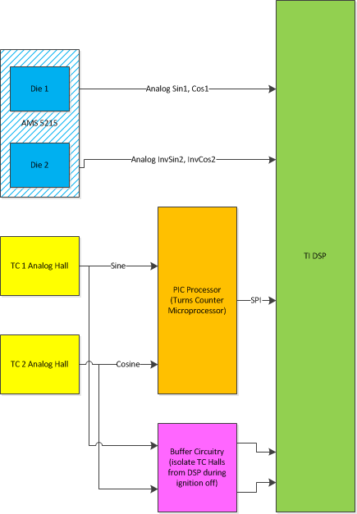
SE45B – Limp Home Motor Position Sensor including Redundant Motor Position Sensor (2 Analog Halls)
Description
  Provide “Limp Home” functionality for diagnostic failures of one of the two primary motor position signals of the dual die motor position sensor.
  Utilize two analog hall sensors as redundant motor position sensors (as used in the the Turns Counter function for Ford) as the diagnostic check for the remaining healthy motor position signal (die) while in Limp Home mode.
Motivation (Performance, 3/4)
Deliverables
  System, subsystem, and FDD requirements for function.
  Prototype software suitable for customer use on test track.
  Final production SW FDD’s
  Test plans
  Modifications to EOL cal process for analog hall signals
Timing
  FDD requirements for PSR complete by June 15, 2014
  PSR Software to customer by end of August 2014
  SOP, Ford S550, March 2016
  SOP, GM T1XX Level 2, April 2018
Team Members/Customers
  Systems - MC&S: Julie Kleinau, Prerit Pramod
  Systems – Functional Safety: Kathy Pattok, Scott Weiss,
  Mark Norman
  FE PSR support – Ali Husain
  ES - ?
  Customers – Ford S550/P552 PDT, GM T1XX Pursuit Team

Slide 2
SE45B – Limp Home Motor Position Sensor including Redundant Motor Position Sensor (2 Analog Halls)
Status
  System Level Requirements Drafted
  Agreement on Customer Accessible Fault Injection Point Reached
  FDD Requirements Drafted, need revisions due to recent decision to make hardware change.
  FE PSR successfully demonstrated on a typical production part (includes approximately 80% of required features)
  FDD Model for Motor Position under development (was not previously a model-based FDD)
  Decision made to insist on hardware change to route TC Hall signals directly to DSP to improve the resolution, reliability, and latency of the TC derived angle signal. (remove PIC from signal path).
Challenges
  Confirm Stack Analysis of motor angle derived from Turns Counter halls signals, raw signals have significant amplitude mismatch, offset error, quadrature error.
    Model complete, but predicts higher amplitudes than measured. Most likely contributor is model map of field strength at TC Hall locations. Need to verify magnetic field map of sense magnet (Roller group).
    Plan is to provide corrections for offset, amplitude, and quadrature, including run time offset learn.
  Hardware change will delay providing prototype to Ford for evaluation.
    TC Hall signals will be routed to DSP directly with buffer circuitry. May or may not be able to move analog halls to smaller radius to increase signal amplitude and reduce error.
  Investigate root cause of why stack analysis of error is not matching measured data. (Kleinau/Roller group)
  Complete FDD modifications for September PSR for customer use (Pramod)
  Test function on a “worst case” stack part to confirm robust function. (MC team)

Slide 3
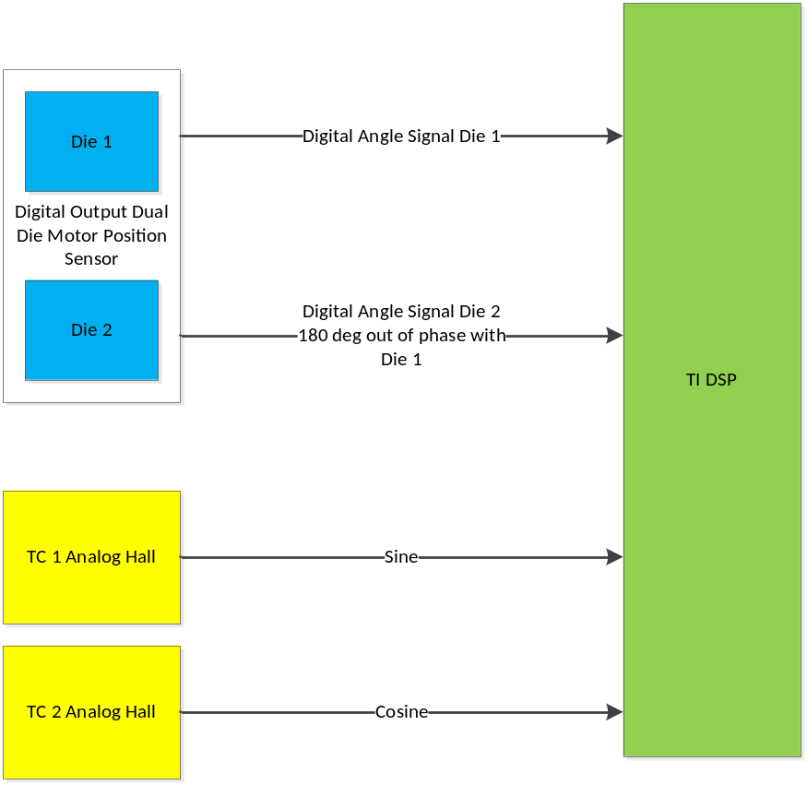
SE45B – Limp Home Motor Position Sensor including Redundant Motor Position Sensor (2 Analog Halls)
GM T1XX Level 2 Proposal

